Slide 1

Saddlepoint and Kernel density approximations
Reed Shay
Mentor: Dr. Indika

Slide 2
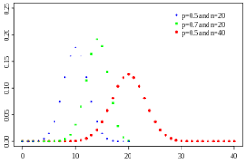
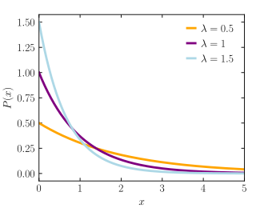
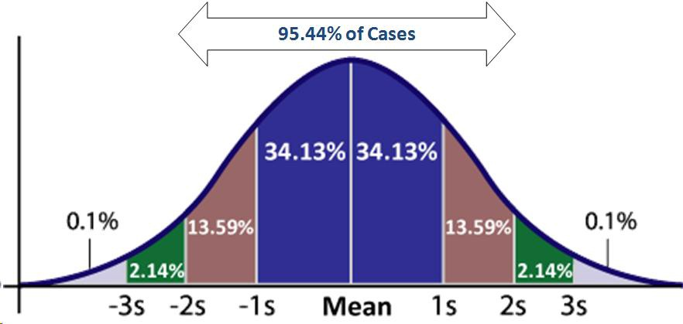
Background Material
Continuous v Discrete Random Variable
Probability Mass Function (PMF)
Probability Density Function (PDF)
Three Distributions :
1) Binomial Distribution
2) Exponential Distribution
3) Normal Distribution

Slide 3
Purpose?
Comparing probability mass/density functions with estimates
Compare estimates
Error Calculations

Slide 4
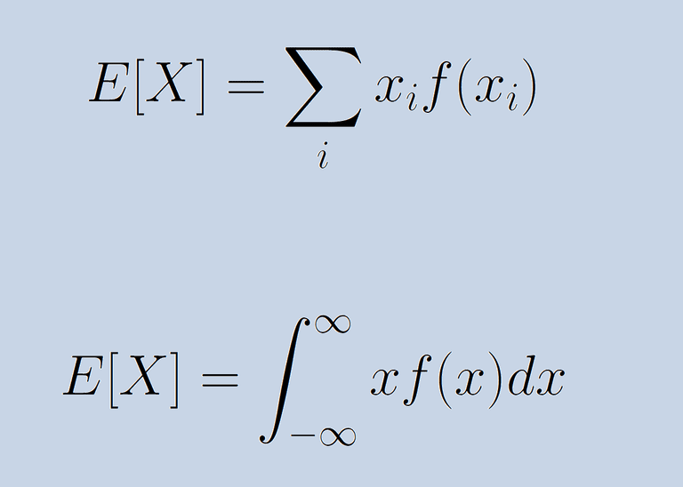
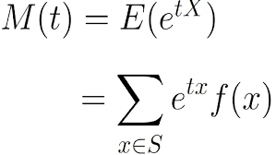
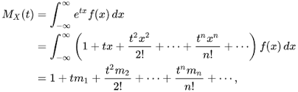

Saddle Point Approximation Method
To approximate the probability distribution with only the Moment generating function (MGF)
${MGF}_{x}\left(t\right)=E[e^{tx}]$
MGF of Discrete Random Variables
MGF of Continuous Random Variables

Slide 5
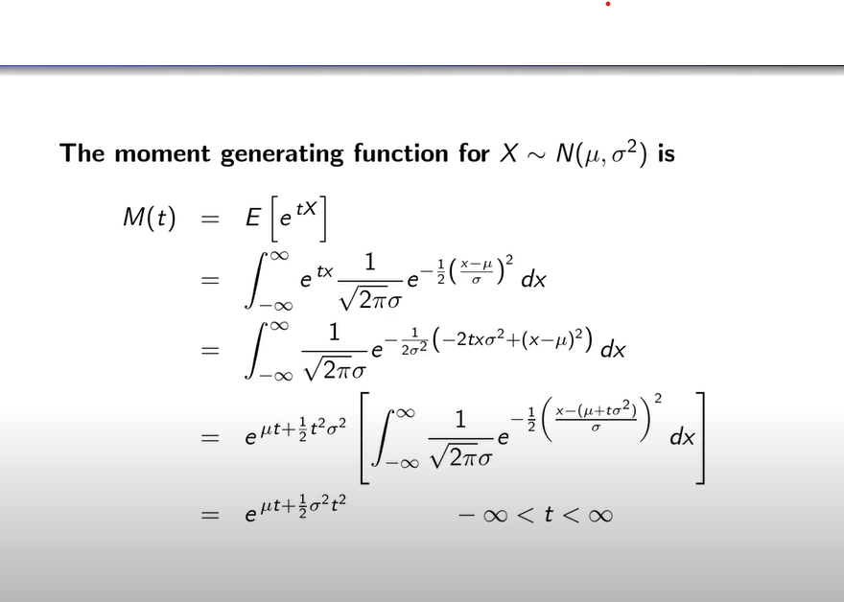

MGF of Normal, Binomial, and Exponential Distributions
MGF of Normal Distribution (cont)
MGF of Binomial
MGF of Exponential

Slide 6
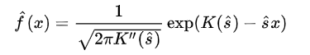

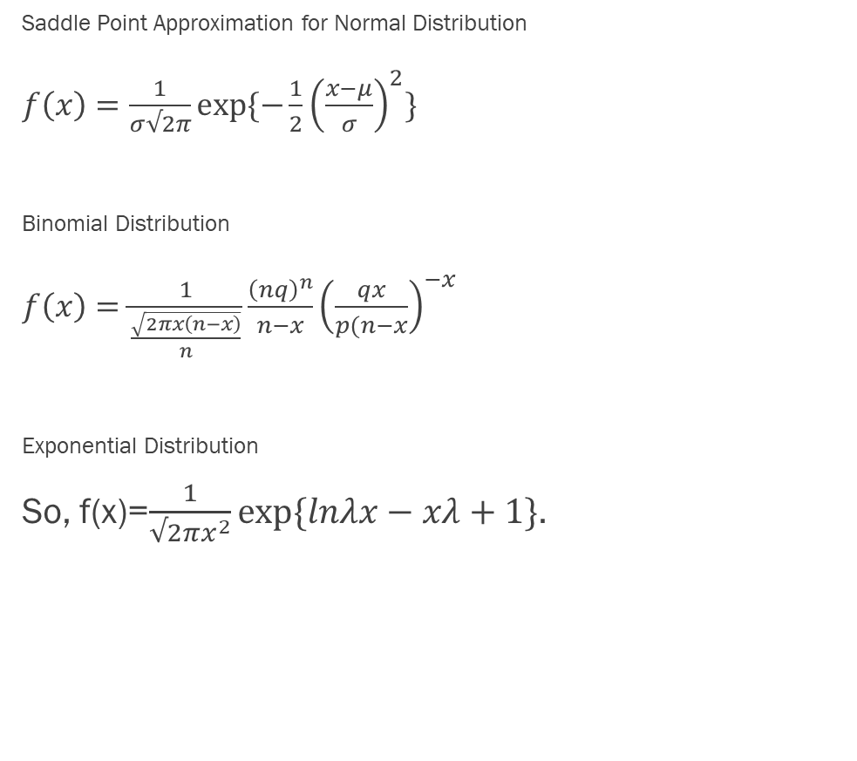
Cumulative Generating Function
Saddle Point Approximation for Normal Distribution
$f\left(x\right)=\frac{1}{σ√2π}exp⁡\{−\frac{1}{2}{\left(\frac{x−μ}{σ}\right)}^{2}\}$
Binomial Distribution
$f\left(x\right)=\frac{1}{\frac{\sqrt{2πx\left(n−x\right)}}{n}}\frac{{\left(nq\right)}^{n}}{n−x}{\left(\frac{qx}{p(n−x}\right)}^{−x}$
Exponential Distribution
So, f(x)=$\frac{1}{√2πx^{2}}exp⁡\{lnλx−xλ+1\}$.
Simply defined as $K\left(s\right)=\ln{M\left(s\right)}$
We have all parts for the saddlepoint approximation

Slide 7
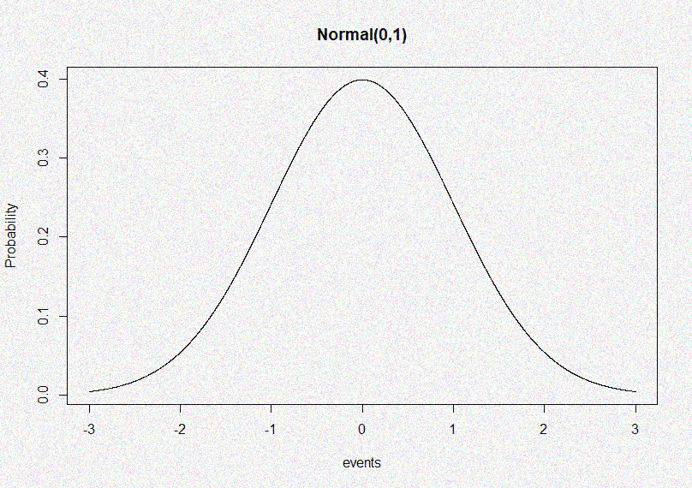
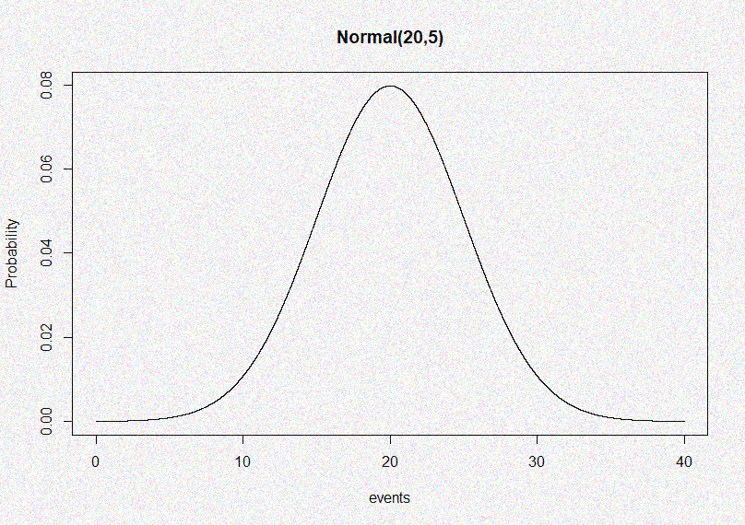
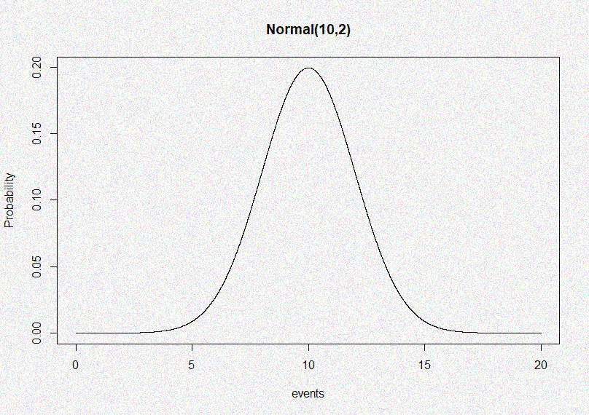
Normal Distribution v Saddlepoint
Saddlepoint $f\left(x\right)=\frac{1}{σ√2π}exp⁡\{−\frac{1}{2}{\left(\frac{x−μ}{σ}\right)}^{2}\}$ = PDF

Slide 8
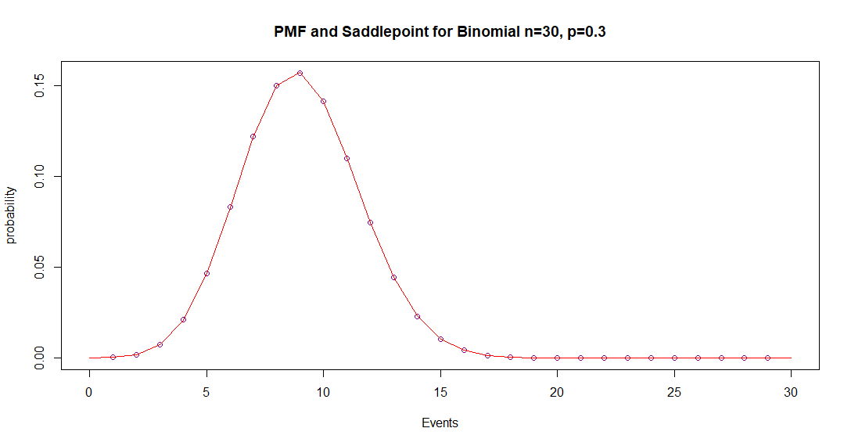
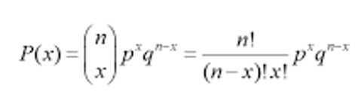
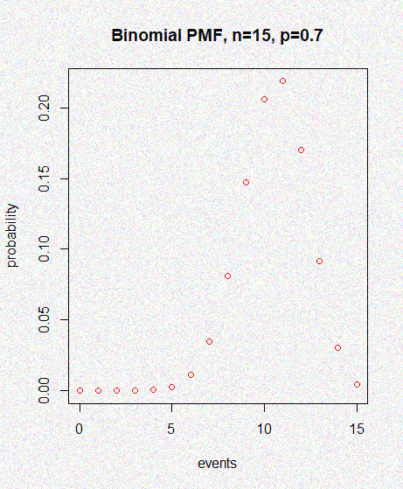
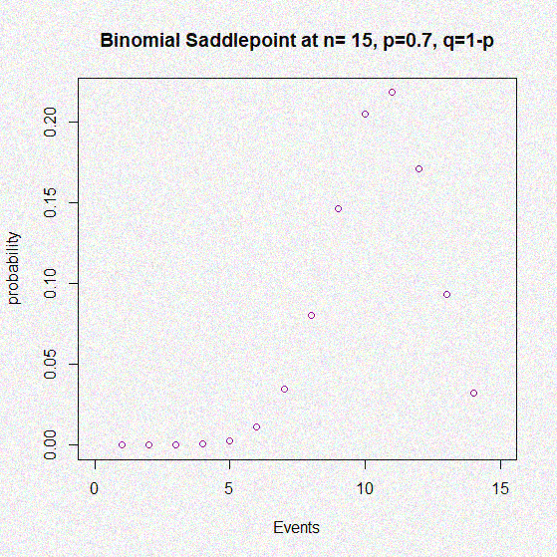
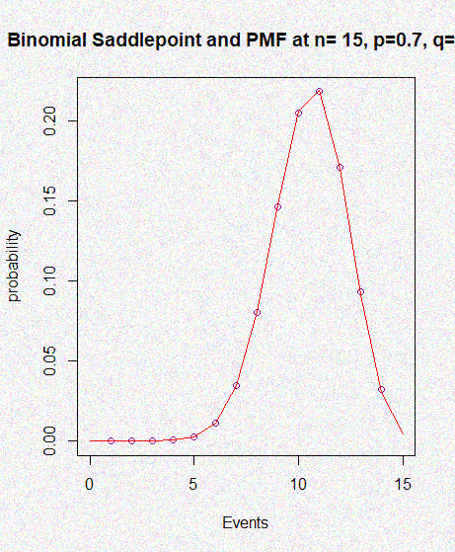
Binomial Distribution v Saddlepoint
v $f\left(x\right)=\frac{1}{\frac{\sqrt{2πx\left(n−x\right)}}{n}}\frac{{\left(nq\right)}^{n}}{n−x}{\left(\frac{qx}{p(n−x}\right)}^{−x}$
,q=1-p
1-p

Slide 9
Cont.
 | Binomial Distribution (n=15, p=0.7)
Integration Intervals | Probability Density Function | Saddlepoint Approximation | PDF- Saddlepoint
0, 2.5 | 0.00001807167 | 0.0000124038 | 5.66787e-06
0, 5 | 0.002162631 | 0.001792563 | 0.000370068
0, 7.5 | 0.05580796 | 0.0515064 | 0.00430156
0, 10 | 0.3814439 | 0.3749159 | 0.00430156
0, 12.5 | 0.8633654 | 0.8660804 | -0.002715
0, 15 | 1 | 0.9999997 | .00000003
 | Binomial Distribution (n= 30, p=0.3)
Integration Intervals | Probability Density Function | Saddlepoint Approximation | PDF- Saddlepoint
0, 3 | 0.005703696 | 0.005128107 | 0.000575589
0, 6 | 0.1180477 | 0.1155421 | 0.0025056
0, 9 | 0.5101517 | 0.5115993 | -0.0014476
0, 12 | 0.8780929 | 0.881298 | -0.032051
0, 15 | 0.9883313 | 0.9891212 | -0.0007899
0, 18 | 0.9995944 | 0.9996536 | -0.0037096

Slide 10
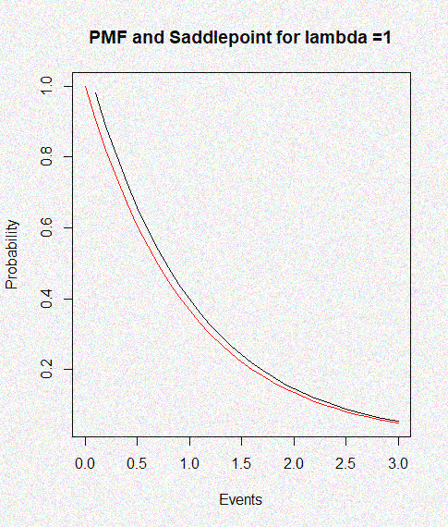
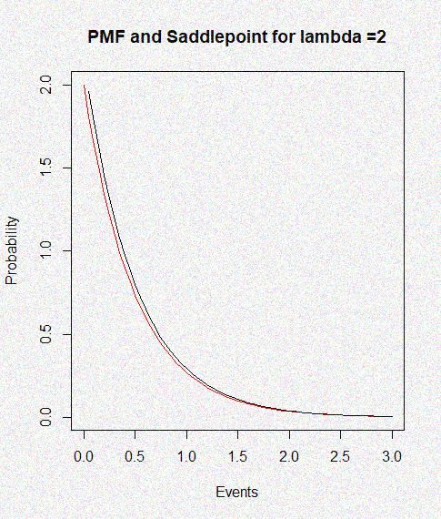
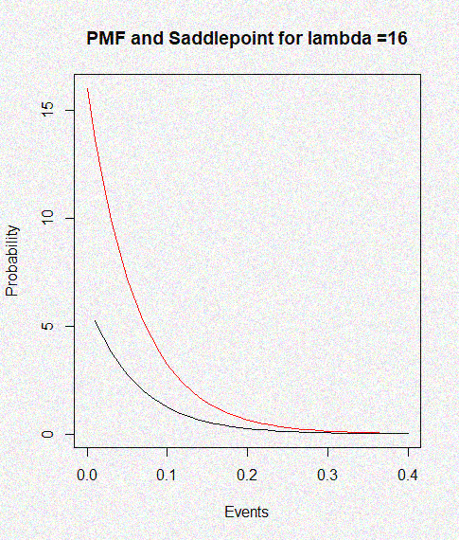
Exponential v Saddlepoint
So, f(x)=$\frac{1}{√2πx^{2}}exp⁡\{lnλx−xλ+1\}$

Slide 11
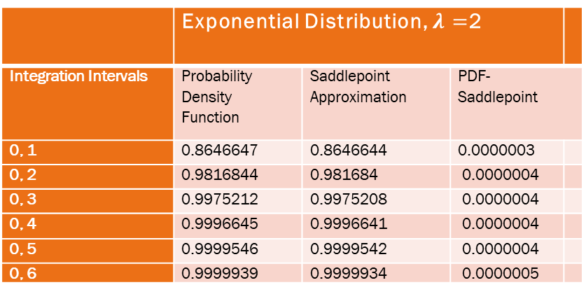
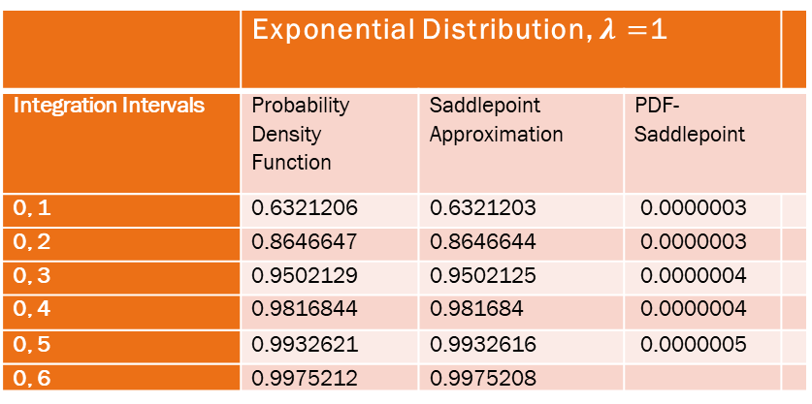
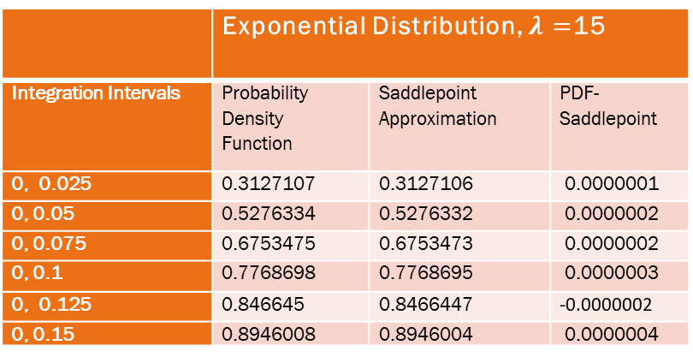
Cont.
 | Exponential Distribution, $λ=$1
Integration Intervals | Probability Density Function | Saddlepoint Approximation | PDF- Saddlepoint
0, 1 | 0.6321206 | 0.6321203 | 0.0000003
0, 2 | 0.8646647 | 0.8646644 | 0.0000003
0, 3 | 0.9502129 | 0.9502125 | 0.0000004
0, 4 | 0.9816844 | 0.981684 | 0.0000004
0, 5 | 0.9932621 | 0.9932616 | 0.0000005
0, 6 | 0.9975212 | 0.9975208
 | Exponential Distribution, $λ=$15
Integration Intervals | Probability Density Function | Saddlepoint Approximation | PDF- Saddlepoint
0, 0.025 | 0.3127107 | 0.3127106 | 0.0000001
0, 0.05 | 0.5276334 | 0.5276332 | 0.0000002
0, 0.075 | 0.6753475 | 0.6753473 | 0.0000002
0, 0.1 | 0.7768698 | 0.7768695 | 0.0000003
0, 0.125 | 0.846645 | 0.8466447 | -0.0000002
0, 0.15 | 0.8946008 | 0.8946004 | 0.0000004
 | Exponential Distribution, $λ=$2
Integration Intervals | Probability Density Function | Saddlepoint Approximation | PDF- Saddlepoint
0, 1 | 0.8646647 | 0.8646644 | 0.0000003
0, 2 | 0.9816844 | 0.981684 | 0.0000004
0, 3 | 0.9975212 | 0.9975208 | 0.0000004
0, 4 | 0.9996645 | 0.9996641 | 0.0000004
0, 5 | 0.9999546 | 0.9999542 | 0.0000004
0, 6 | 0.9999939 | 0.9999934 | 0.0000005

Slide 12
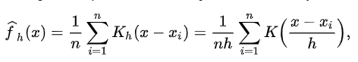
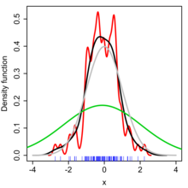
Kernel Density Estimation
Estimation of PDF- Finite sample data to influences of population
K = Kernel
h = bw

Slide 13
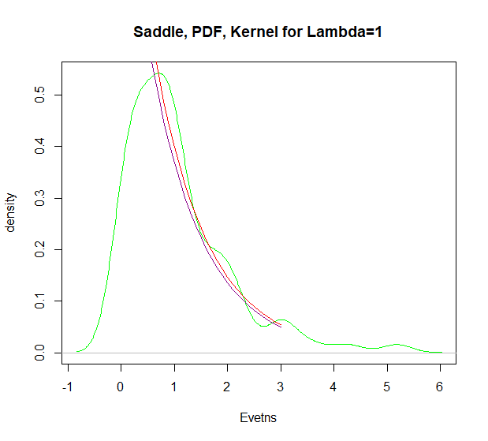
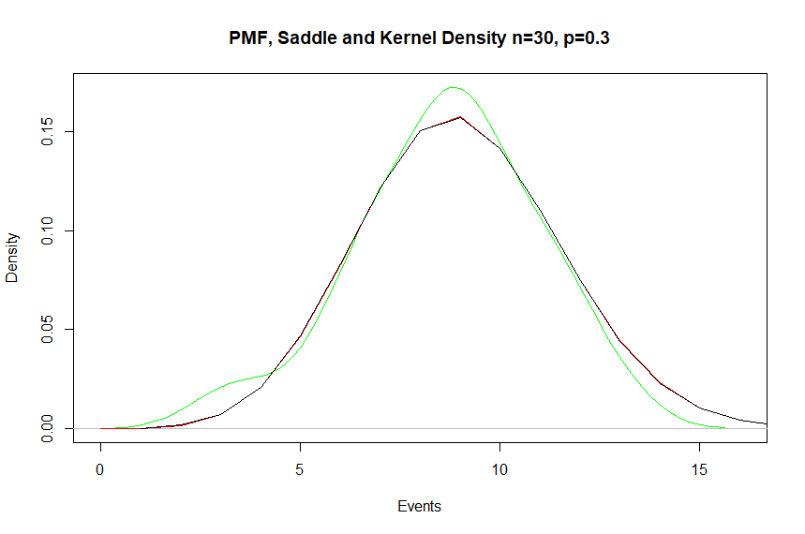
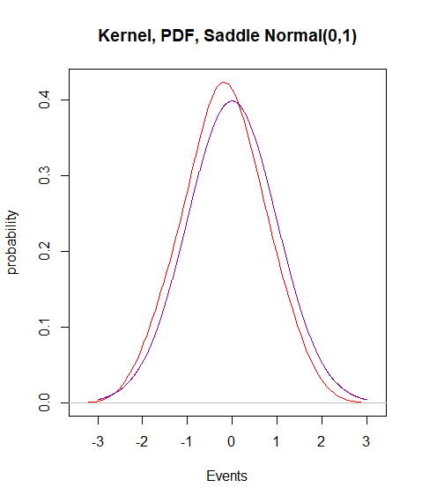
Kernel Density Estimates
Exponential
Binomial
Normal

Slide 14
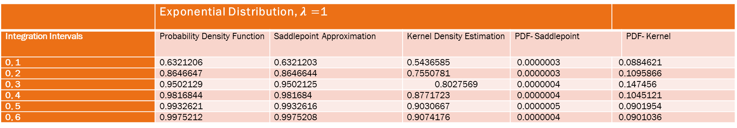
Cont.
 | Binomial Distribution (n= 30, p=0.3)
Integration Intervals | Probability Density Function | Saddlepoint Approximation | Kernel Density Estimation | PDF- Saddlepoint |  | PDF- Kernel
0, 3 | 0.005703696 | 0.005128107 | 0.02150911 | 0.000576 | -0.015805414
0, 6 | 0.1180477 | 0.1155421 | 0.1365063 | 0.0026267 | -0.0184586
0, 9 | 0.5101517 | 0.5115993 | 0.543113 | -0.0014476 | -0.0329613
0, 12 | 0.8780929 | 0.881298 | 0.9170552 | -0.0032051 | -0.0389623
0, 15 | 0.9883313 | 0.9891212 | 0.9991123 | -0.0007899 | -0.0007899
0, 18 | 1 | 0.9996536 | 1 | 0.003464 | 0
 | Exponential Distribution, $λ=$1
Integration Intervals | Probability Density Function | Saddlepoint Approximation | Kernel Density Estimation | PDF- Saddlepoint |  | PDF- Kernel
0, 1 | 0.6321206 | 0.6321203 | 0.5436585 | 0.0000003 | 0.0884621
0, 2 | 0.8646647 | 0.8646644 | 0.7550781 | 0.0000003 | 0.1095866
0, 3 | 0.9502129 | 0.9502125 | 0.8027569 | 0.0000004 | 0.147456
0, 4 | 0.9816844 | 0.981684 | 0.8771723 | 0.0000004 | 0.1045121
0, 5 | 0.9932621 | 0.9932616 | 0.9030667 | 0.0000005 | 0.0901954
0, 6 | 0.9975212 | 0.9975208 | 0.9074176 | 0.0000004 | 0.0901036
 | Normal Distribution (0,1)
Integration Intervals | Probability Density Function | Saddlepoint Approximation | Kernel Density Estimation | PDF- Saddlepoint | PDF- Kernel
-inf, -3 | 0.00135 | 0.00135 | 0.00001747537 | 0 | 0.0013325246
-inf, -2 | 0.02275 | 0.02275 | 0.01998448 | 0 | 0.00276552
-inf, -1 | 0.15866 | 0.15866 | 0.1843602 | 0 | -0.0257002
-inf, 0 | 0.5 | 0.5 | 0.580239 | 0 | -0.080239
-inf, 1 | 0.84134 | 0.84134 | 0.8999521 | 0 | -0.0586121
-inf, 2 | 0.97725 | 0.97725 | 0.9948644 | 0 | -0.0176144
-inf, 3 | 0.99865 | 0.99865 | 0.9999988 | 0 | -0.013488

Slide 15
Further Research/Conclusions
Error calculation, Percent error?
Integration Intervals?
Bw exploration
Kernel Exploration

